Slide 1
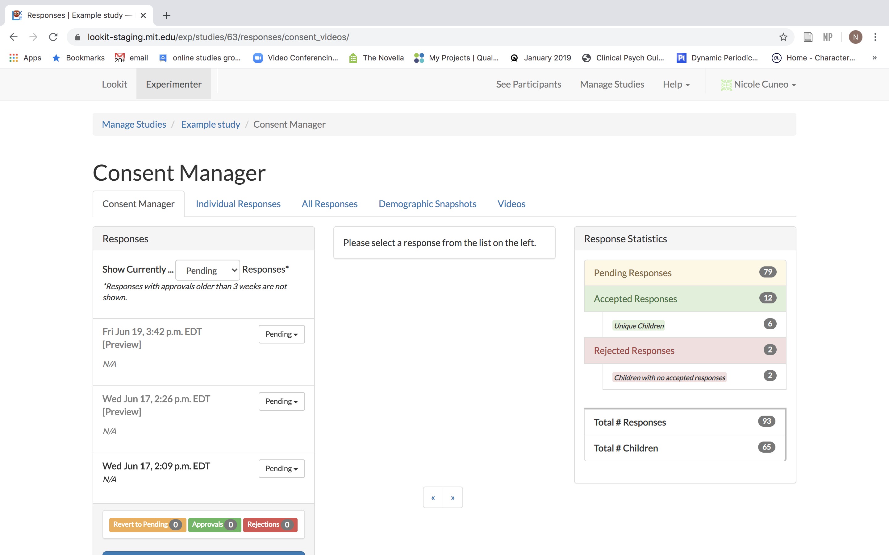
Notes:
Slides by Nicole Cuneo – please credit if reusing portions!

Slide 2
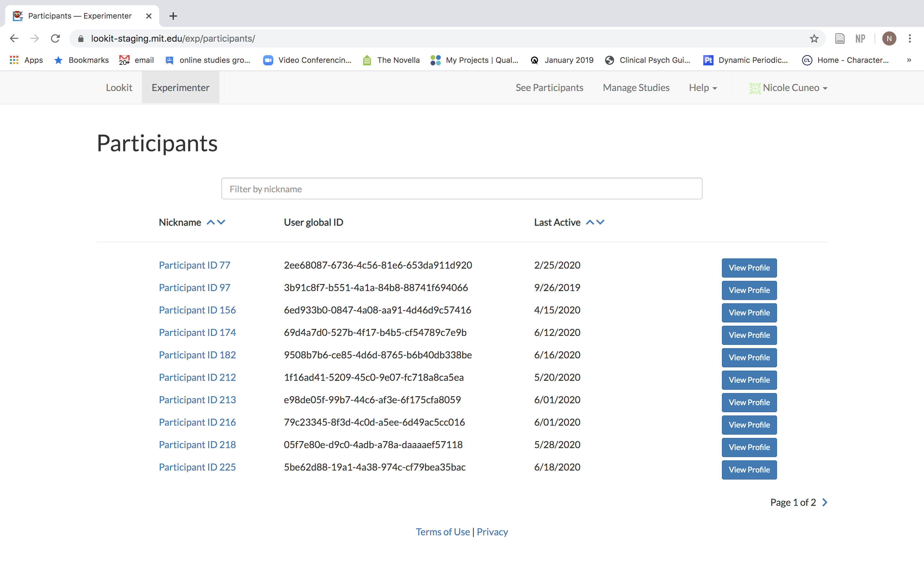
Individual Info re: families
ID Number (given by Lookit)
Notes:
Note – global IDs generally not ok to share, this is ok because it’s the staging server and not real data!

Slide 3
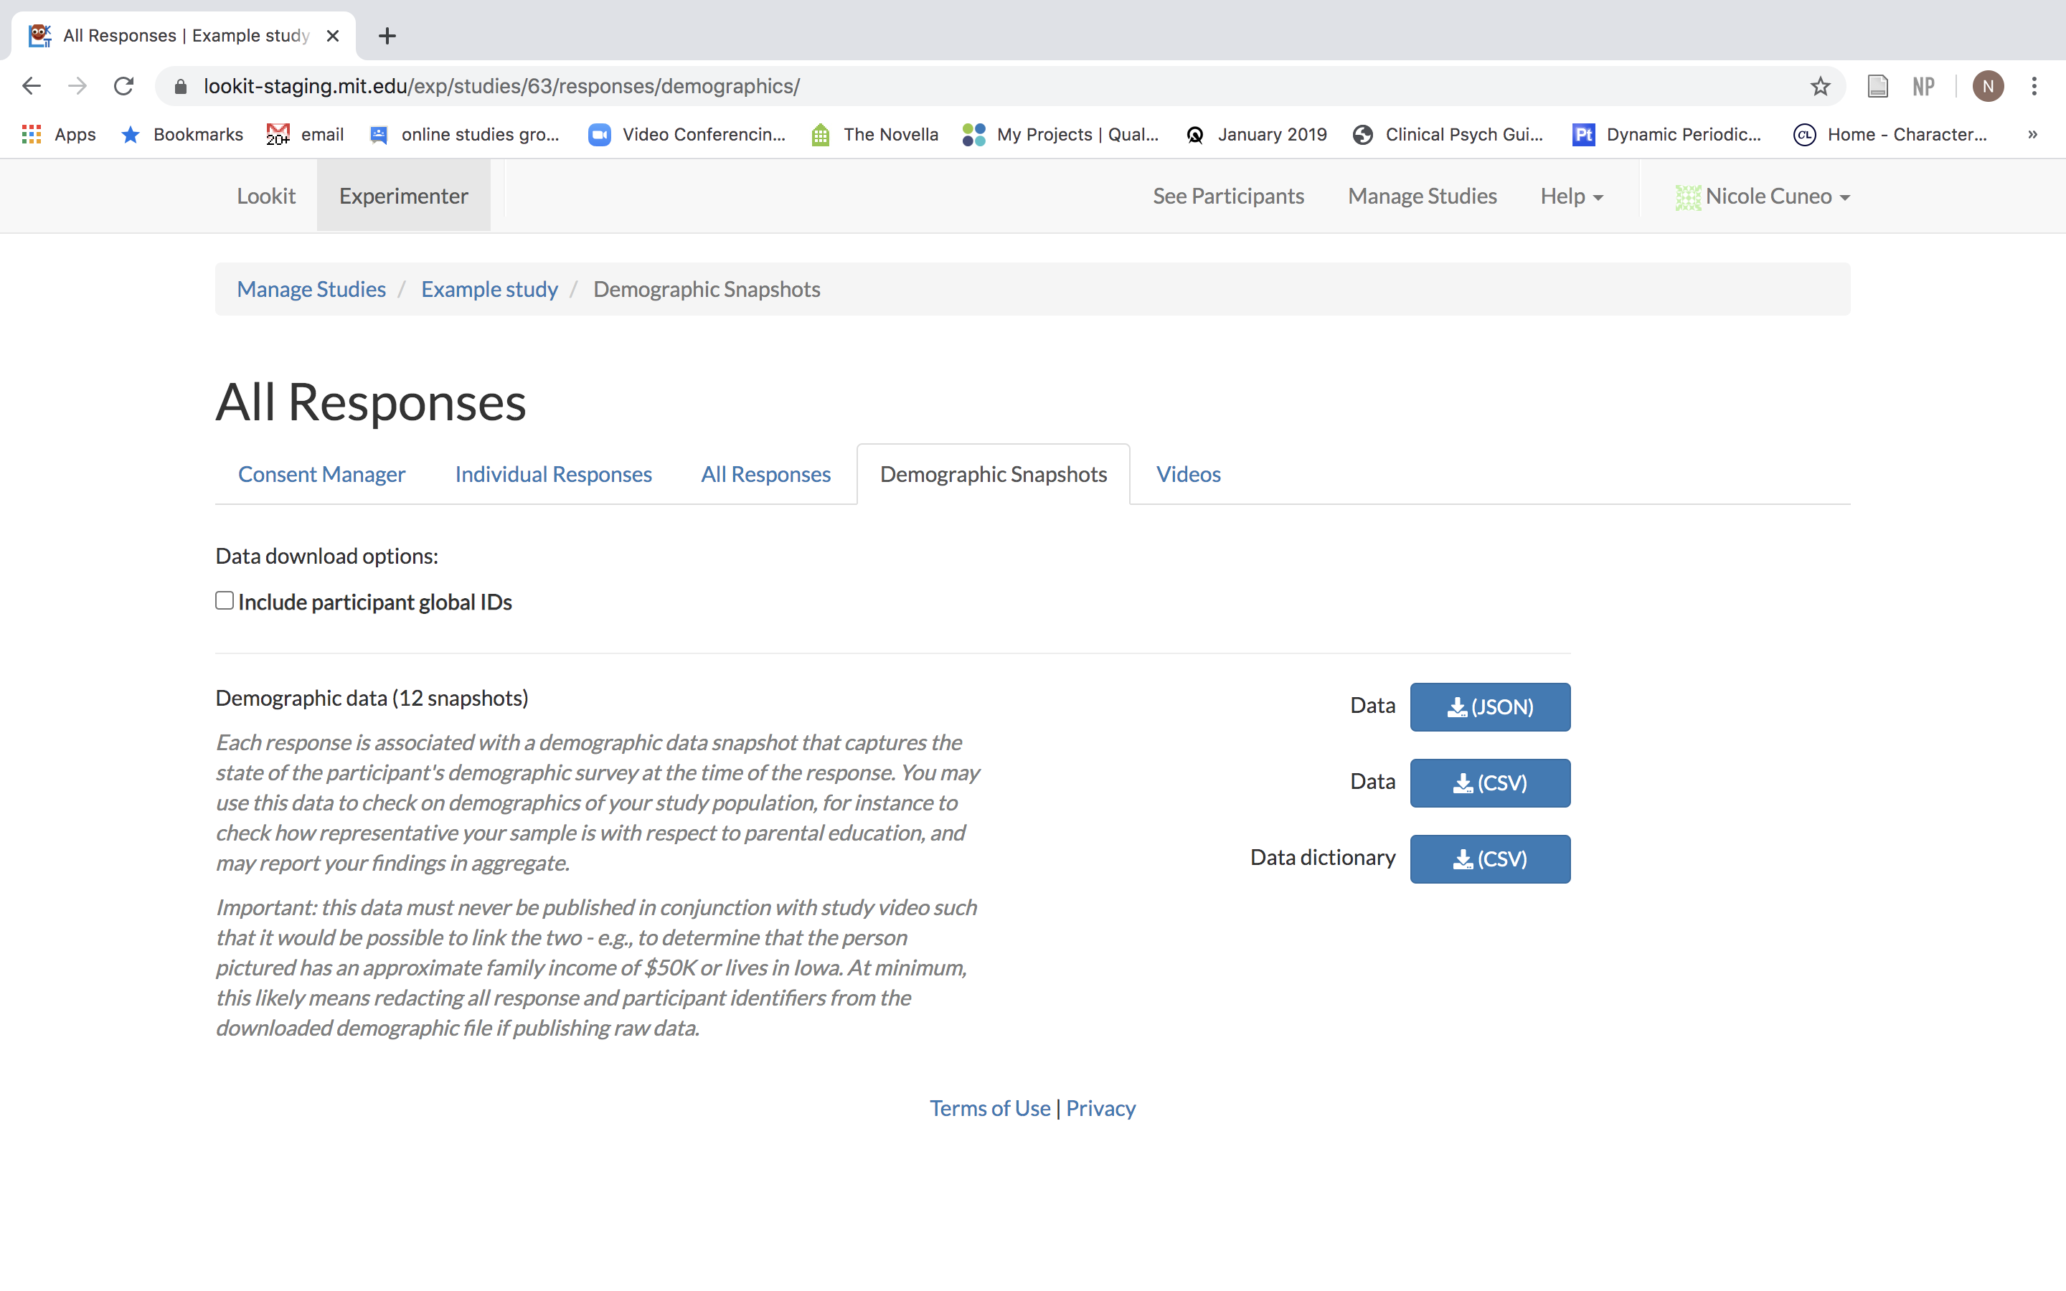
Downloadable demographics info

Slide 4
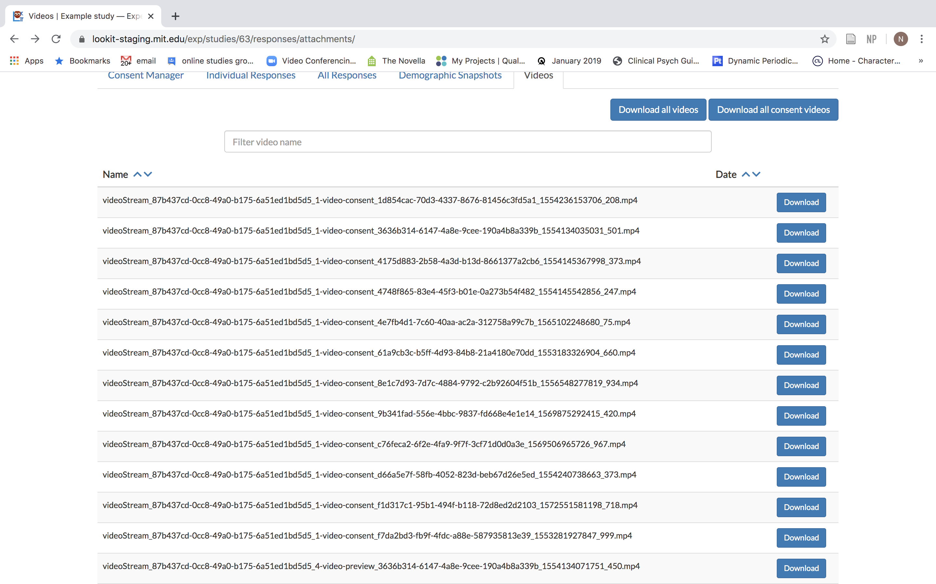

Slide 5
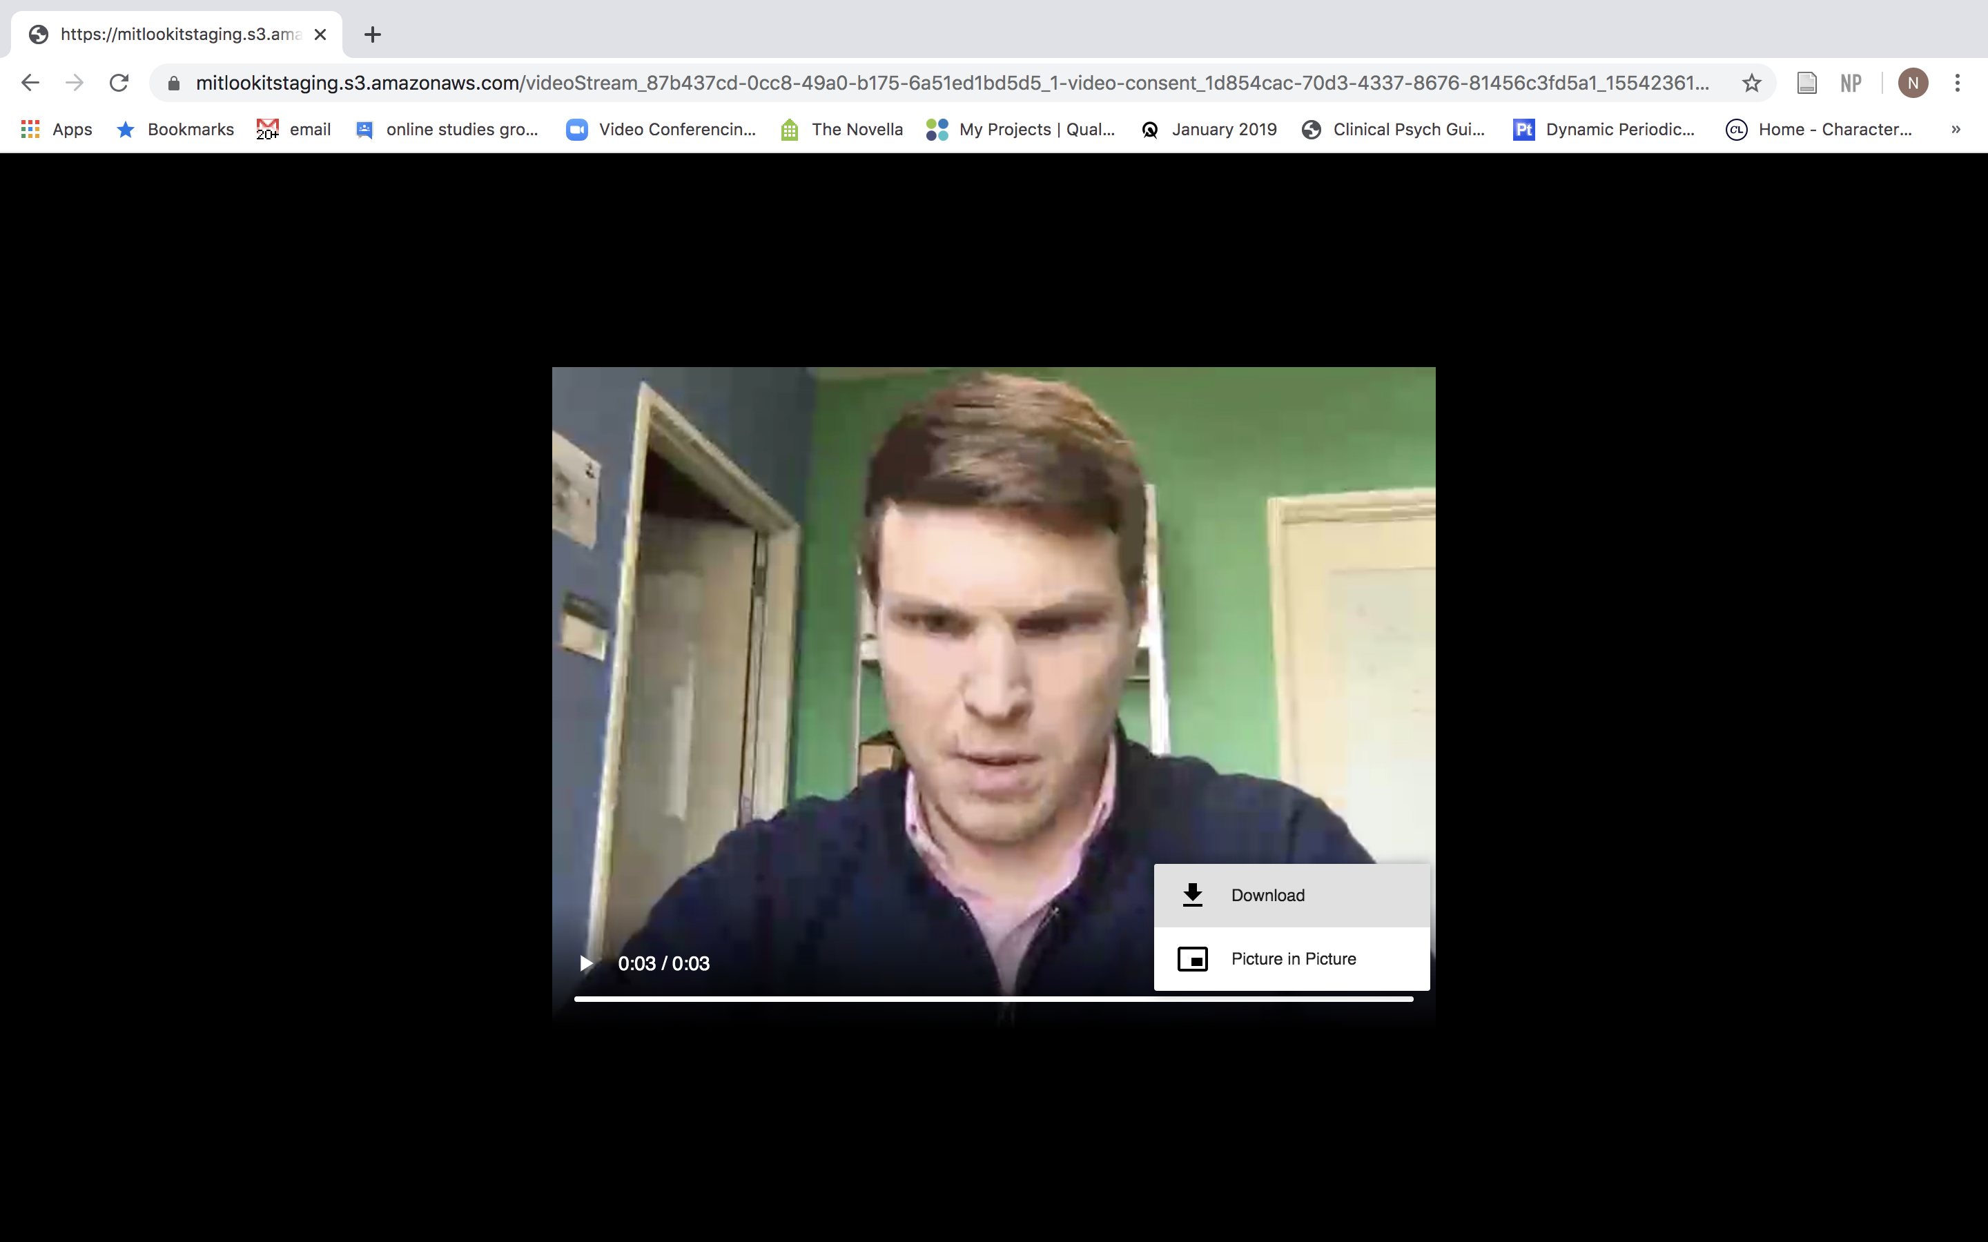
-Can preview
-Download to code

